Slide 1






SPACE MISSION ANALYSIS
PRESENTATION BY : TEAM-4

Slide 2
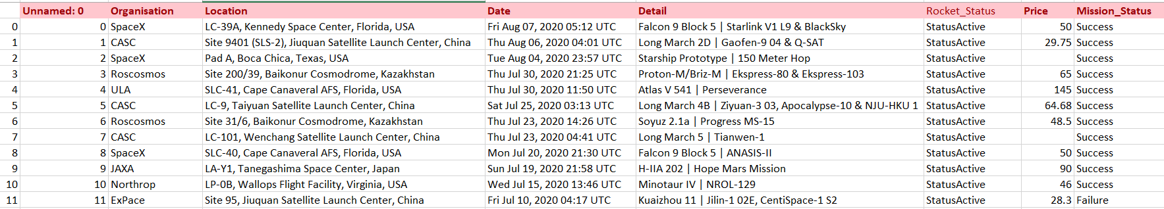
INTRODUCTION
A dataset capturing the history of global space missions
Contains 4,300+ missions spanning several decades.
Key fields: Organisation, Location, Date, Rocket details, Status, Price, Mission outcome.
Data in its raw form (missing values, inconsistent formats, mixed text).
Serves as the foundation for analyzing success rates, agency performance, and technology evolution.

Slide 3

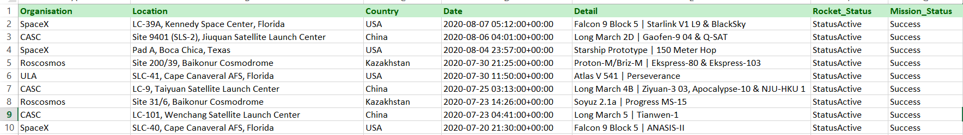
DATA CLEANING & PREPARATION
Load Raw Data:
4324 rows, 9 columns.
Remove Unnecessary Columns:
Dropped Unnamed columns; filled Price missing values with median.
Fix Data Types:
Date in datetime format.
Remove Outliers:
Cleaned unrealistic prices.
Final Clean Dataset:
Kept: Organisation, Location, Date, Detail, Rocket_Status, Price.
No duplicates, consistent data types.

Slide 4
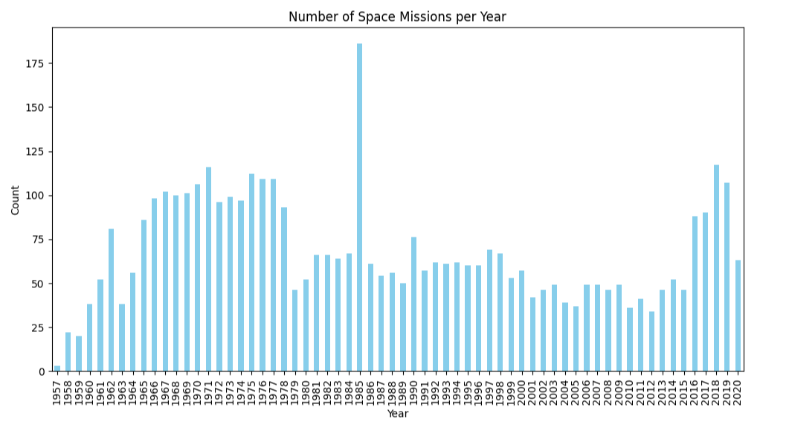
Q1. DISTRIBUTION OF MISSIONS OVER TIME
1. Distribution of missions over time
Graph Type: Bar Plot
Insight: Reveals growth cycles & disruptions; peaks = space race/private sector surge, declines = budget or geopolitical impact

Slide 5
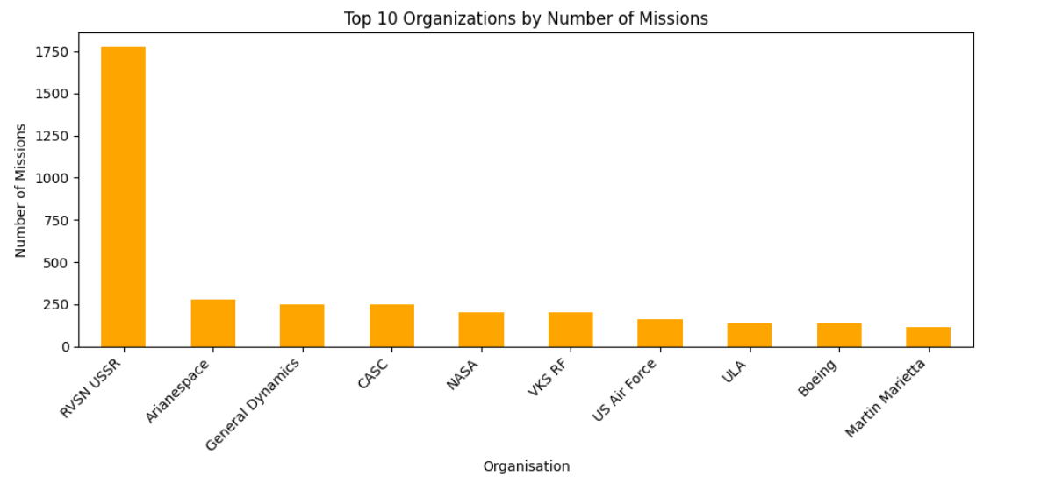
Q2. TOP 10 ORGANIZATIONS BY MISSIONS
2. Top 10 Organizations by Missions
Graph Type: Bar Plot
Insight: Highlights the most active space agencies/companies; dominance shifts from govt. agencies (NASA, Roscosmos) to private players (SpaceX).

Slide 6
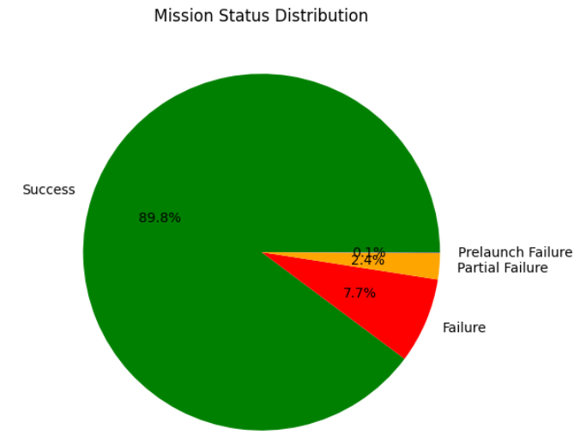
Q3. MISSION SUCCESS VS FAILURE
3. Mission Success vs Failure
Graph Type: Pie Chart
Insight: Shows risk vs reliability trends; high failure rates indicate testing or emerging players.

Slide 7
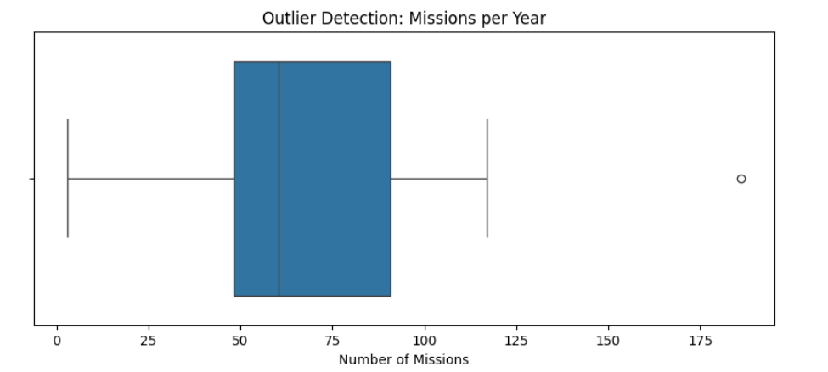
Q4 Outlier Detection (missions per year)
4. Outlier Detection (missions per year)
Graph Type: Bar Plot
Insight: Detects unusual years highlighting external shocks; also uncovers data quality issues.

Slide 8
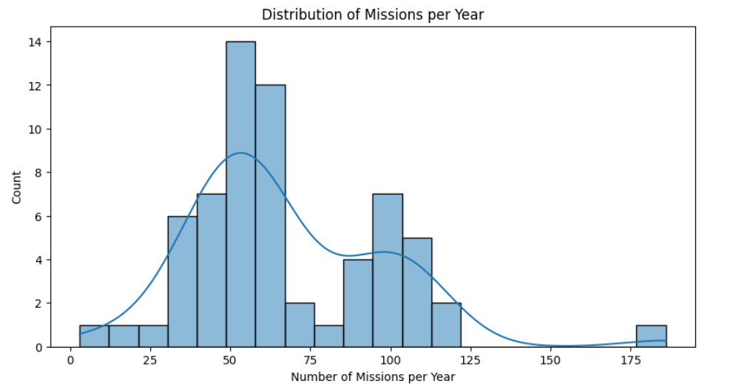
Q5. Normality Check of Missions Per Year
5. Normality Check of Missions Per Year
Graph Type: Histogram and Q-Q plot
Insight: The distribution of missions per year is not normal, with a skew towards fewer missions in earlier years.

Slide 9
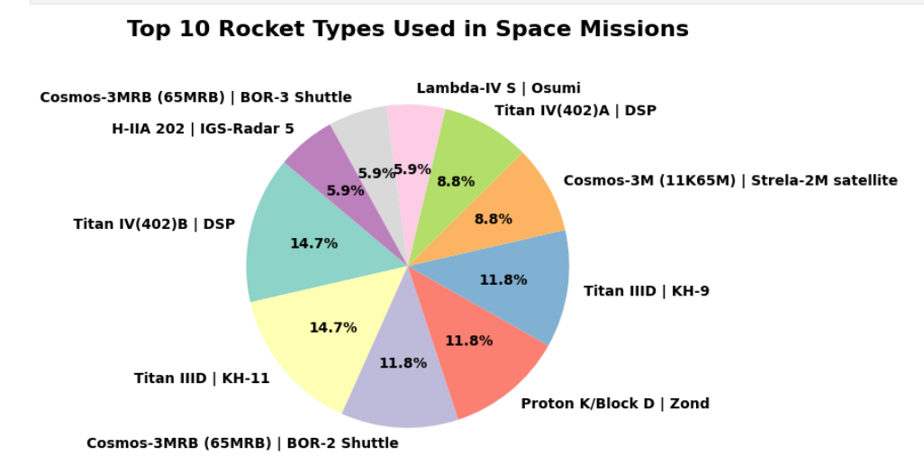
Q6 Missions by Rocket Type
Q6 Missions by Rocket Type
Graph Type: Bar Plot
Insight: This shows which rockets are used most frequently for missions.

Slide 10
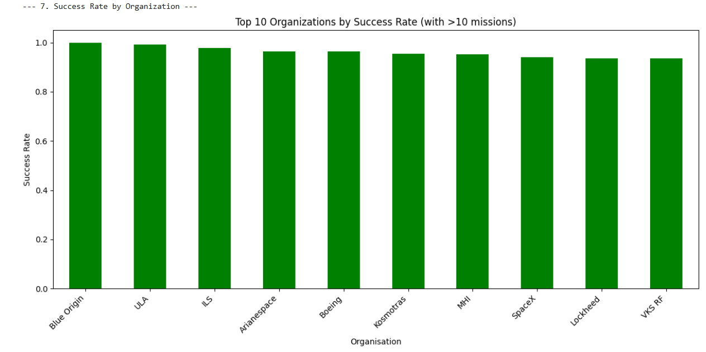
Q7 Success Rate by Organization
7. Success Rate by Organization
Graph Type: Bar Plot
Insight: Compares organizational reliability; shows consistently high success for leading agencies, with newer/private players catching up.

Slide 11
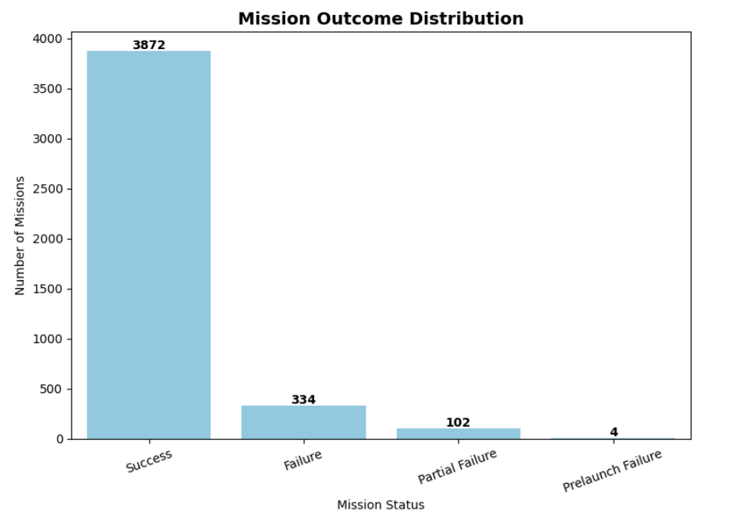
Q8. Failure Causes Distribution
8. Failure Causes Distribution
Graph Type: Bar Plot / Pie Chart
Insight: Breaks down main reasons for mission failures; highlights technical faults, launch vehicle issues, and early-stage testing risks.

Slide 12
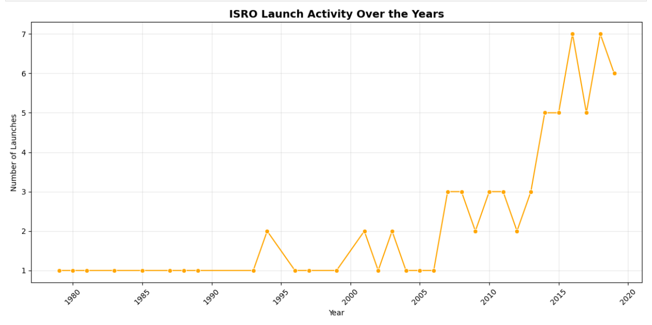
9.ISRO Launches every year
Graph Type: Scatter/bubble
The x-axis of the graph represents the years, showing , while the y-axis showing num of launches
Q9.ISRO launches every year

Slide 13
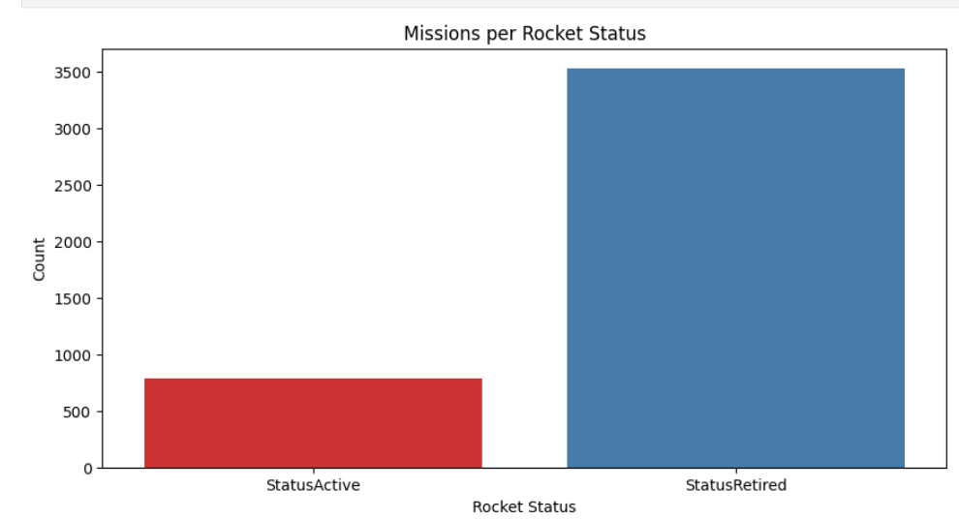
Q10 Missions per Rocket Status
10. Missions per Rocket Status
Graph Type: Bar Plot
Insight: Compares active vs retired rockets; shows reliance on a few workhorse launch vehicles and phasing out of older models.

Slide 14
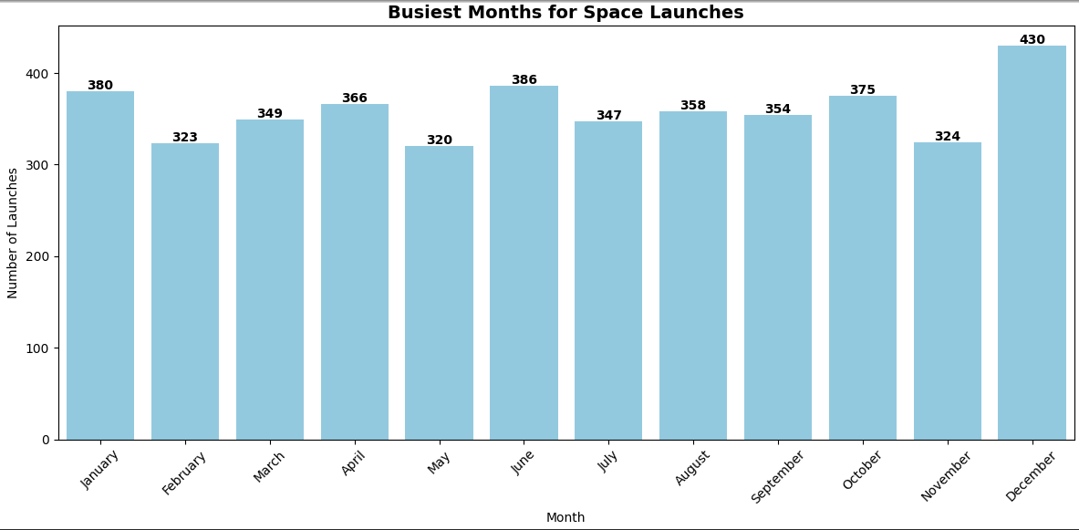
Q11 Busiest Months for Space Launches
11. Busiest Months for Space Launches
Graph Type: Bar Plot
Insight: Identifies peak launch months; shows seasonal patterns and scheduling preferences in space programs.

Slide 15
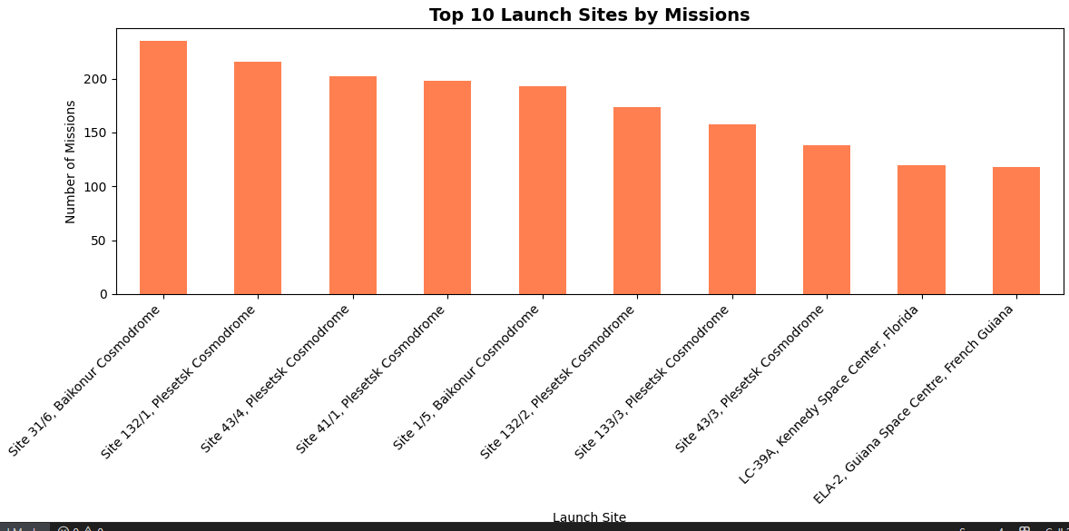
Q12 Top 10 Launch Sites by Missions
12. Top 10 Launch Sites by Missions
Graph Type: Bar Plot
Insight: Shows most frequently used launch sites; highlights dominance of Baikonur, Cape Canaveral, and emerging commercial sites.

Slide 16
THANK YOU

